Slide 1
Primary care reform collaborative
December 12, 2022

Slide 2
Virtual meeting- housekeeping
Public- please send your name, email contact, and organization affiliation (if applicable) to stephanie.hartos@delaware.gov or write in the meeting chat box.
Please keep your computer/phone on mute unless you are making a comment, and if you are not on visual, please identify yourself as well.
This meeting will be recorded for minutes.

Slide 3
AGENDA
Call to Order
Approval of September 2022 Meeting Minutes
University of Delaware Primary Care Study- Discussion
PCRC Workgroups- Update
  Payment and Attribution- Dr. Nancy Fan
  Care Coordination- Dr. Nancy Fan
  Quality Measures and Benchmarks- Cari Miller
Department of Insurance Office of Value Based Health Care Delivery- Update
2023 Meeting Schedule- Discussion
Public Comment

Slide 4
University of Delaware: primary care provider study
Dr. Nancy Fan, Chair
  PCRC Discussion of PCP study

Slide 5
Pcrc workgroup updates:
PAYMENT AND ATTRIBUTION & CARE COORDINATION
Dr. Nancy Fan
  Chair of the Payment and Attribution & Care Coordination Workgroups

Slide 6
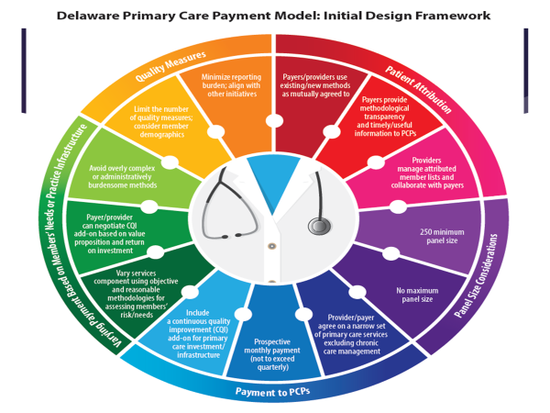
Delaware’s primary care (pc) payment model

Slide 7
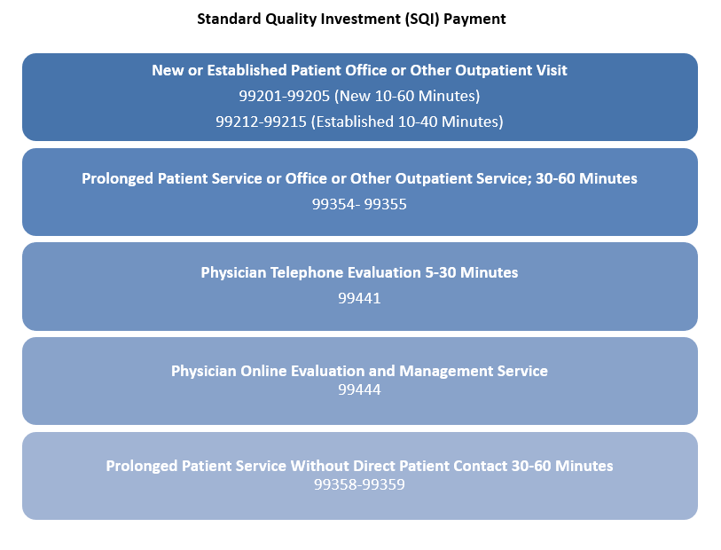

Slide 8
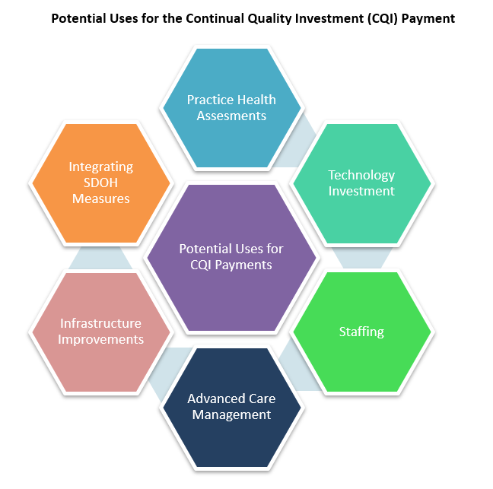

Slide 9
Pcrc workgroup updates:
QUALITY MEASURES AND BENCHMARKS
Cari Miller
  Chair of the Quality Measures and Benchmarks Workgroup

Slide 10
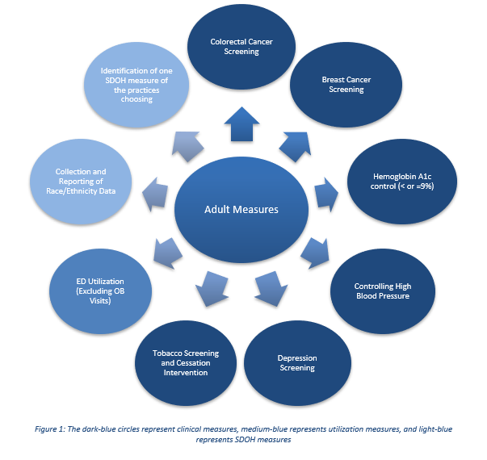

Slide 11
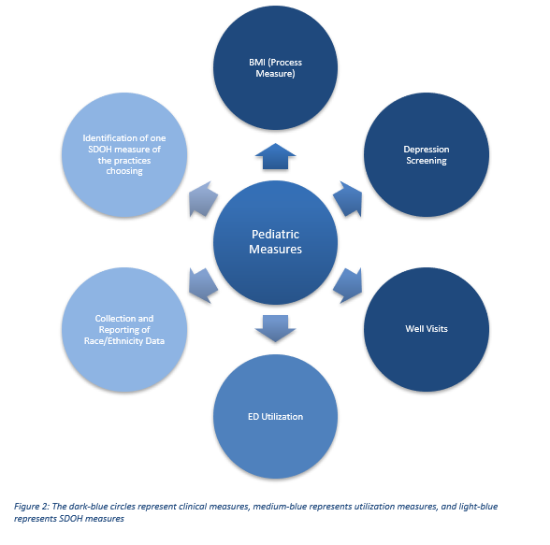

Slide 12
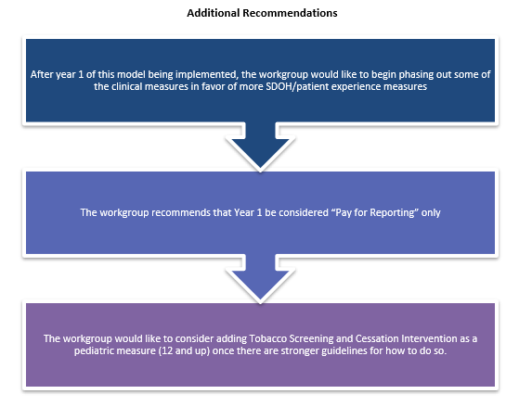

Slide 13

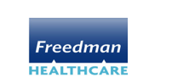

2022 Affordability Standards Compliance Update
Office of Value Based Health Care Delivery (OVBHCD)
Cristine Vogel, MPH, CPHQ
Director, Office of Value Based Health Care Delivery Delaware Department of Insurance
Mary Jo Condon, MPPA
Principal Consultant
Freedman HealthCare
© 2022 Freedman HealthCare, LLC

Slide 14
About the Office of Value Based Health Care Delivery
Established in 2019 by the General Assembly as an Office within the Department of Insurance
Key Responsibilities
Establish mandatory minimums for payment innovations, including alternative payment models, provider price increases, carrier investment in primary care to achieve a robust system of primary care by 2026
  Includes data collection, stakeholder engagement, regulation development and compliance
Develop and annually evaluate affordability standards, through an open and transparent process, in collaboration with the Primary Care Reform Collaborative
Evaluate compliance with the requirements of SS 1 for SB 120 and its related regulations

Slide 15

Theory of Change
Unit price growth for certain services decreases
Primary care investment
increases
Alternative payment model adoption expands
Spending on preventable ED and hospital visits
decreases
Access to comprehensive primary care expands
Incentives to provide appropriate care increases
Care delivery and patient outcomes improve

Slide 16
Five Requirements for Fully-Insured Commercial Health Plans
Requirements | Description
1. Medicare Parity | Reimburse at least as much as Medicare for primary care and chronic care management services.
2. Primary Care Investment | Reach minimum, annual thresholds for providers in care transformation programs.
3. Care Transformation | Target including 75% of primary care providers in care transformation programs by 2026.
4. Price Growth Limits | Limit price growth for hospital and other non-professional services to better align with growth in the overall economy.
5. APM Adoption | Expand meaningful alternative payment model adoption by making healthcare providers more accountable for spending and value.

Slide 17
Highlights from Initial Compliance Review
All carriers project compliance with all requirements of SB 120 and related statutes and regulations.
The Office estimates primary care investment will increase approximately $8 million more in 2023 with the passage of SB 120 than it would have without passage of the legislation.
The Office estimates savings of $2 million to $12 million in 2023 due to limits on price growth for non-professional services.
Less than half of healthcare spending for Delaware fully-insured commercial members is tied to a fee-for-service only contract.

Slide 18
1. Medicare Parity for Primary Care and Chronic Care Management Services
Medicare Parity Requirements
Fee for Service Requirement
Carriers must reimburse providers for primary care and chronic care management services at a rate no less than the Delaware Medicare Physician Fee Schedule (MPFS). Carriers may apply certain business rules so long as the resulting reimbursement is at least as much as Medicare would have paid.
Non-Fee-for-Service Reimbursement Requirement
Carriers must offer primary care providers the opportunity to receive non-fee-for-service payments for primary care services not typically reimbursed on a fee-for-service basis. Such as:
Care management
Care coordination
Incentive programs
Other care transformation activities
SS 1 for SB 120 & REGULATION 1322 REQUIREMENTS

Slide 19
1. Medicare Parity for Primary Care and Chronic Care Management Services
NOTES ON 2023 COMPLIANCE
APPLICATION OF BUSINESS RULES
All carriers were materially in compliance with both components of the Medicare parity requirement.
One carrier is working to identify a limited number of instances in which fee-for-service underpayment occurred and provide appropriate compensation to impacted providers.
For some carriers, non-fee-for-service programs will begin as a pilot and expand to other primary care providers over the next two to three years.
Allowed:
Advanced Practice Practitioner provided the service
Multiple services provided during the same visit
Not Allowed:
Provider paid below Medicare for some codes but, on average, above it
Provider billed less than the Medicare rate
Notes:
Fee-for-service Medicare parity has been a statutory requirement since 2018. The Office previously assessed compliance for 2019 and 2020 and reported similar findings. Carriers have adjusted reimbursement processes and/or amended provider contracts to comply with the law.

Slide 20
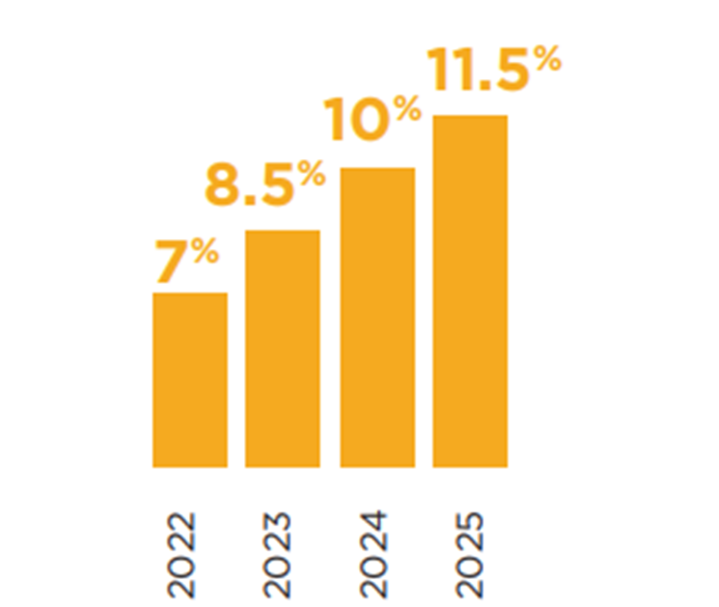
2. Primary Care Investment Requirements
For the 2023 plan year, carriers must increase primary care investment to a minimum of 8.5% of total medical expense.
Required Level of Investment
OVBHCD calculates projected spending for Delawareans who are “attributed to” or regularly visit Delaware primary care providers who participate in care transformation activities.
SS 1 for SB 120 & REGULATION 1322 REQUIREMENTS

Slide 21
2. Primary Care Investment
NOTES ON COMPLIANCE
All carriers project they will be in compliance for the 2023 plan year.
The Office estimates primary care investment will increase approximately $8 million more in 2023 with the passage of SB 120 than it would have without passage of the legislation.

Slide 22
2. Primary Care Investment

Slide 23
2. Primary Care Investment
Notes:
Carriers project 35% of fully-insured Delawareans will be attributed to a primary care provider participating in care transformation activities in 2023.

Slide 24
2. Primary Care Investment

Slide 25
3. Care Transformation Requirements
Carriers must target 75% of primary care providers in care transformation activities by 2026.
To qualify, primary care providers must:
Enroll in a carrier program that provides additional payments to primary care providers working to achieve advanced primary care capabilities
Achieve National Committee for Quality Assurance Patient-Centered Medical Home Recognition (PCMH)
Participate in the Delaware Primary Care Model (in development by the PCRC)
SS 1 for SB 120 & REGULATION 1322 REQUIREMENTS

Slide 26

3. Care Transformation
Team-Based Care & Care Management
Active Use of Data
Examples of Care Transformation Activities
Planned Care at Every Visit
Effective Management of Tests & Referrals
Integration of Primary Care & Social Services
Integration of Primary Care & Behavioral Health

Slide 27
4. Limits on Price Growth for Hospital and Other Non-Professional Services
For the 2023 Plan Year:
5.5% price growth limit to reflect inflationary environment and labor costs
Moving forward:
Limits: Carrier rate filings must not include aggregate unit price growth for nonprofessional services that exceeds the greater of Core CPI + 1%
Defining Core CPI: Average of previous 12 bimonthly indices for DE region, ending January 31st of the rate filing year
Services included: Non-professional services include inpatient, outpatient and other medical services as defined by the Unified Rate Review Template (URRT)
SS 1 for SB 120 & REGULATION 1322 REQUIREMENTS

Slide 28
4. Limits on Price Growth for Hospital and Other Non-Professional Services
NOTES ON COMPLIANCE
All carriers project compliance.
Challenges achieving those projections may include:
  Some health systems’ reluctance to adjust contracts as necessary to support compliance with the law.
  Without the limits on price growth for non-professional services, funding the required increased primary care investment may not be feasible.

Slide 29
4. Limits on Price Growth for Hospital and Other Non-Professional Services

Slide 30
4. Limits on Price Growth for Hospital and Other Non-Professional Services

Slide 31
5. Alternative Payment Model Adoption
Expand APM Adoption
FIXED PAYMENT METHODOLOGY
By plan year 2024, carrier rate filings will reflect fee schedules and reimbursement structures for inpatient and outpatient hospital facility services delivered in Delaware based on a fixed payment, episode-based, or population-based payment methodology (e.g., not a percent of charges)
No specific compliance requirement for the 2023 plan year
OVBHCD will be issuing additional guidance for the 2024 plan year
TOTAL COST OF CARE ACCOUNTABILITY
For large carriers (more than 10,000 Delaware residents across all fully-insured products)
Program design elements regarding risk corridors (i.e., minimum shared savings rate and minimum loss rate) and loss sharing limits consistent with the Medicare Shared Savings Program (MSSP) Pathways model.
No specific compliance requirement for the 2023 plan year
SS 1 for SB 120 & REGULATION 1322 REQUIREMENTS

Slide 32
5. Alternative Payment Model Adoption: Total Cost of Care Accountability

Slide 33
Next Steps
Ongoing
Release report providing overview of projected compliance
March 2023
Release Bulletin with additional guidance for 2024 plan year
Summer 2023
Carrier submissions provide updated projections for 2023 plan and projections for 2024
Quarterly compliance calls with each carrier
Early
2023

Slide 34
APPENDIX
Additional Implementation Guidance Shared with Carriers
Extend across self-insured members - greatest opportunity to transform care across patient base
Align program goals to leverage provider resources across carriers
Seek opportunities for smaller practices to “buy in” to shared services (e.g., care management, integrated behavioral health)
Layer multiple types of payment programs to balance provider need for guaranteed revenue and carrier need for accountability
Recognize the upfront investment for providers and hesitancy to join programs where carrier investment is delayed or uncertain.
Enact some provider accountability mechanisms to ensure members receive access and value in exchange for these investments.

Slide 35
2023 Meeting Schedule
Currently, the PCRC is meeting virtually on a quarterly basis.
Should the PCRC decide to continue that cadence, the following 2023 schedule is proposed:
  March 13, 2023, 4:00-6:00pm
  June 12, 2023, 4:00-6:00pm
  September 11, 2023, 4:00-6:00pm
  December 11, 2023, 4:00-6:00pm
All meetings will continue to be virtual until informed otherwise.

Slide 36
Public comment

