Slide 1
Interested Providers

Slide 2
Welcome!
Prior to the start of your license application
Be sure you have the correct regulations
Review all the reference material

Slide 3
Delaware Initial Application Process Steps for Home Care Agencies
1. Read regulations.
2. Complete the application, and checklist in its entirety with the required nonrefundable fee (certified check or money order only). Prepare all documents in a binder according to checklist instructions. Do not use plastic page covers. Deliver to the Office of Health Facilities Licensing and Certification (OHFLC).
3. The Division reviews your application for completeness.
3a. Application incomplete – The applicant is notified to pick up documents (including the application fee) with a list of the missing items. Return to Step 2.
4. Application is accepted for further review; the applicant will receive an email stating the following:
• Forwarded for review
• The time frame for review is 6-9 months or longer.
• Do NOT contact the Division regarding the status.
4a. Application approved; the license will be issued.
4b. Requested Further Information: Applicant will receive an email requesting revision(s).
The Agency will have 30 days to respond/email revisions to the requester.
4c. Revisions are not complete and do not meet regulatory guidance. The applicant is sent an
e-mail stating license application is withdrawn. Return to step 2.

Slide 4
Delaware Initial Application Process Steps for Home Care Agencies Continued
5. Final License disposition
5a. Application was withdrawn from consideration. Return to Step 2
5b. Application approved; the initial license will be issued for the first 90 days.
6. Unannounced survey to occur to confirm compliance with regulations.
6a. Pass the survey, and the agency receives an annual license.
6b. Agencies with deficiencies must complete an acceptable plan of correction before
getting an annual license.
6c. Agencies that, at the time of an on-site survey, do not meet the definition of the
applicant’s specific agency applying for, or that are not in substantial compliance with
the corresponding regulations will not be granted an annual license.
Please update OHFLC with any change of contact information.
Do not spend any money on business licenses, insurance, office space, hiring personnel, etc. until you are recommended for licensure by our office.

Slide 5

Office of Health Facilities Licensing and Certification (OHFLC)
This office oversees the licensing of over 300 agencies and facilities throughout the state. This number is growing with every new agency. We are responsible for all state and federal complaint investigations and compliance surveys. Our priority is always the Delaware consumer and the quality of health care they are currently receiving.

Slide 6
Licensure Types
Personal Assistance Services Agency (PASA)
Does not require the judgment and skills of a licensed nurse.
Activities of Daily Living (ADL), companion, transportation, homemaker services by a Direct Care Worker
Home Health Agency – Aide Only (HHAAO)
Provides home health aide services under the supervision of an RN.
Skilled Home Health Agency (HHAS)
Services by licensed professionals – Skilled Nursing (SN), Physical Therapy (PT), Occupational Therapy (OT), Speech/Language Pathologist (SLP)
Must provide two (2) or more home care services, one of which must be either licensed nursing services or home health aide services.
Hospice (HSPC)
Medical care to terminally ill patients and their families.

Slide 7
Overview of the Process
You will complete the application with all of the attachments.
You must have a certified check or money order with the appropriate application fee made out to the State of Delaware. Your application will not be accepted unless the fee is included with a certified check or money order.
You are going to prepare a binder with your completed documents by following the document compliance checklist for the agency type you are interested in opening. You must be compliant with the regulation on the checklists. Please look for the document compliance Review Guide to see what information is expected for each regulation .
Keep in mind that licensure fees are non-refund
You must make a copy your binder for yourself also to reference. Your binder will not be returned.
Once OHFLC has completed the review of your binder, you will be notified of the results. If you do not pass the first submission, you will have one more chance to submit your revisions within 30 days.

Slide 8
Overview of the Process (cont.)
After you have successfully completed Part 1 of the Document Compliance Binder review, you will submit Part 2 of the Initial Licensure Application and Document Compliance Checklist
After successfully completing the Document Compliance Review, you will be granted an Initial 90-day license.
You must notify OHFLC as soon as you begin servicing a client.
OHFLC does not supply clients for any agencies
OHFLC is not involved with any reimbursement for care
Then OHFLC will conduct an unannounced survey at your location.
If you are found to be out of compliance with anything during the survey, you will have to complete a Plan of Correction (PoC). You have a limited number of chances to gain compliance with your PoC. If you cannot gain compliance, you will not receive your full annual license. You will no longer be able to operate an agency caring for patients/consumers.

Slide 9
It is not necessary to have an office, personnel or insurance at this point
Once you pass your document compliance review you will be asked to submit this information with Part 2 of your Initial Licensure Application. Do not spend any money until this step.

Slide 10
Overview of the Process (cont.)
The OHFLC will review your licensure application and document submission using the “Document Compliance Checklist”.
Items marked "not met" did not demonstrate the required regulatory compliance for licensure. These items must be resubmitted for review no later than 30 days from the date of the initial review. If your submission remains non-compliant after the second review, you will have to restart the licensure process and a license will not be issued.
If your submission is compliant, you will be granted a 90-day Initial License.

Slide 11


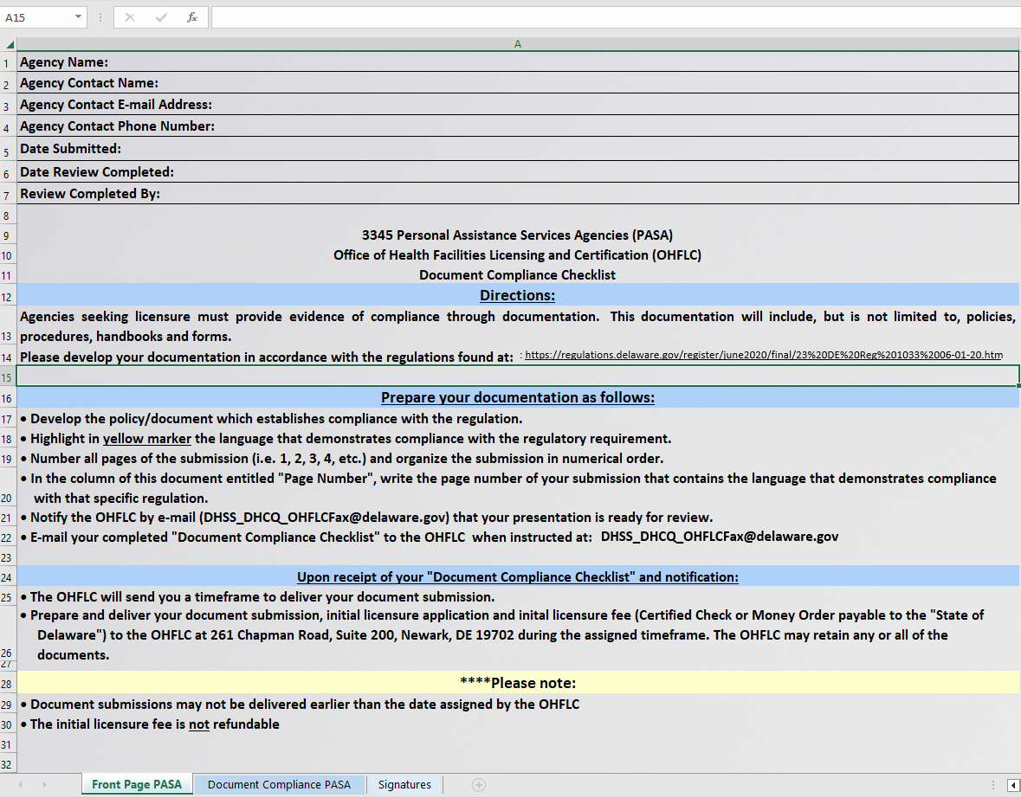


Document Compliance Checklist

Slide 12
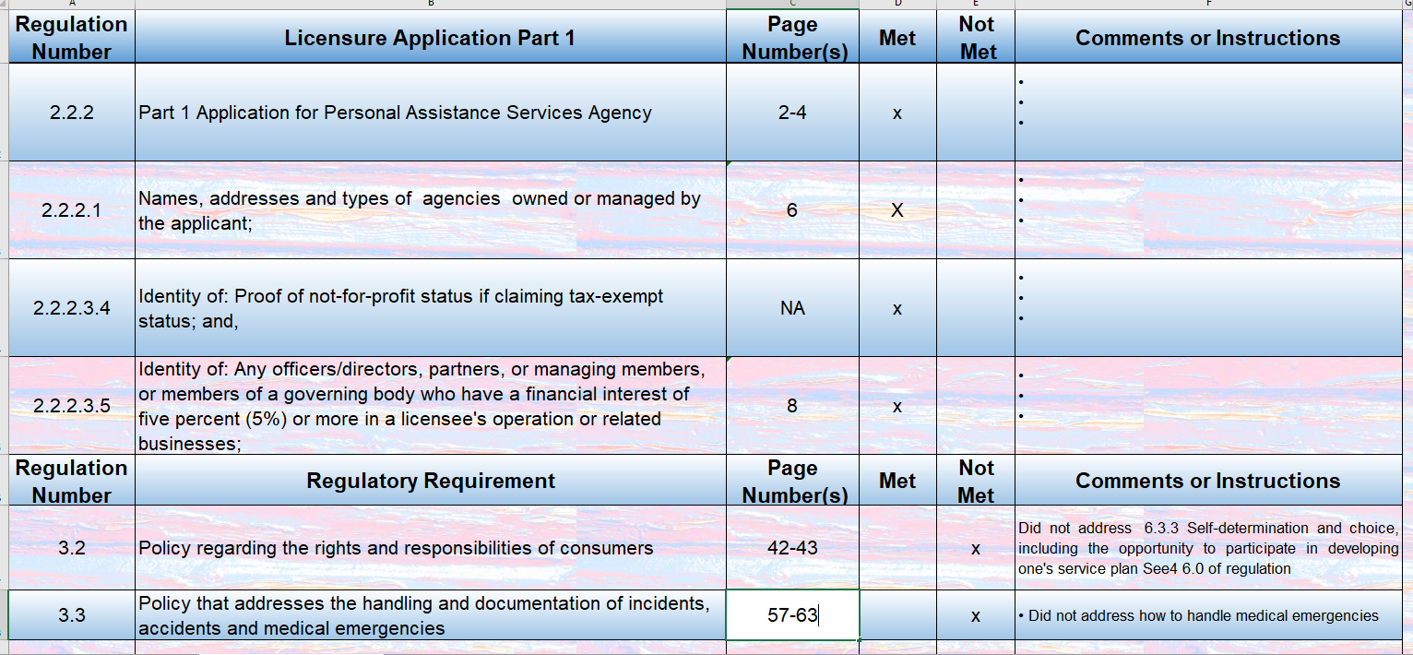
Document Compliance Checklist
Notes:
This checklist does not exhaust all regulatory requirements - it is a beginning of compliance. Some documents will be reviewed in the Binder review, others during the initial survey. It is the responsibility of the agency to ensure they are meeting all regulatory requirements.
If the agency is using an electronic documentation system, they must be able to print from it (in order to provide required documentation to surveyors).

Slide 13
Meeting regulatory Requirements
This checklist and binder does not exhaust all regulatory requirements - it is a beginning of compliance. Some documents will be reviewed in the Binder review, others during the initial survey.
It is the responsibility of the agency to ensure they are meeting all regulatory requirements
This binder is the policies and procedures your agency is going to follow – you are responsible for following them. You need to be familiar with them.
Similarly, you are responsible for following the State of Delaware regulations. This means ensuring your policies and procedures align with and meet regulatory requirements.
If you are opening a franchise, be mindful that all of this applies.

Slide 14
Document Compliance Binders
You are responsible to know what you are submitting in your binder. If you hire a consultant to prepare your binder, you are responsible to know that it meets Delaware’s regulations.
Many consultant firms prepare binders for multiple states.
Delaware’s regulations differ from our surrounding states including New Jersey, Maryland, and Pennsylvania.
Make sure you are following the Delaware regulations for the agency type you are applying to open.

Slide 15
Document Compliance Binder (cont.)
You will need to have a Binder for your agency and one for OHLFC.
OHFLC will retain any and all of the submission documents.
Document submissions may not be delivered to the OHFLC earlier than the assigned timeframe.
The initial licensure fee is not refundable.

Slide 16
Document Compliance Submission Instructions
Number all pages of the submission and organize the submission in numerical order (i.e., 1, 2, 3, 4).
In the column of the Document Compliance Checklist titled “Page Number,” write the page number of your submission that contains the language that demonstrates compliance with that specific regulation.

Slide 17
Document Compliance Submission
Completed Part I licensure application
Licensure fee, certified check or money order (non-refundable)
**No personal / company checks, or cash will be accepted**
Document/Binder submission

Slide 18
Items that should be included in Document Compliance Binder
Policies and Procedures
Staff Development In-service Schedule
Organizational Chart
New Employee Orientation Teaching Material
Competency Tests with Answer Key
Job Descriptions
Annual and New Hire Competencies
Contracts
Forms
Items that you may want to include:
Employee Handbook
Performance Evaluations
Patient/Consumer Handbook
Admission Packet

Slide 19
“Sample Policy Template”
Company Name
Policy Name and Number
Overview or Purpose
Process/Procedure or Policy
(This section needs to contain language that asserts compliance with the regulation. Tag this policy with the regulation number for easy reference at the time of the Document Compliance Meeting and the initial licensure survey.)
Revision History
Origination date: ________ Approved by: ________
Reviewed date: ________ Reviewed by: ________
Revised date: ________ Approved by: ________
Related Documents/Resources

Slide 20
Hand Hygiene Policy and Procedure Example (incomplete policy)
XYZ Agency Policy # 3212
Purpose: To cleanse the hands of germs and prevent contamination between patients and home care personnel. Effective hand hygiene reduces the incidence of infections.
Policy: All personnel providing direct or indirect care/service will wash their hands in the home prior to contact with the client. Indications for hand washing include:
before and after providing direct care to a client after gloves are removed*;
when hands are visibly soiled;
after using the toilet, blowing the nose, or covering a sneeze;
after assisting a patient in using the toilet or changing diapers/protective undergarments;
before eating, drinking, handling, or serving food;
before leaving the patient’s home, as appropriate to the situation.
after trash removal.
Towels, either cloth or paper, and liquid soap will be used if appropriate to the home setting. Waterless hand-washing products may be used if liquid soap and running
water are unavailable or when waterless hand washing is more appropriate to the situation.
PROCEDURE:
Washing with water
Turn on the water, adjust temperature, and wet hands.
Apply the soap and work into a lather using friction, covering the entire hand, top and bottom, for a minimum of 15 seconds.
Pay special attention to the nails and between the fingers and the back of hands.
Rinse hands thoroughly with running water. Dry hands with a paper towel or clean cloth towel.
Turn off faucet with clean paper towel or cloth towel
Washing without water (using hand sanitizer)
Apply recommended amount of product to palm of one hand
Rub hands together, covering all surfaces of hands and fingers and under the nails
Continue to rub until hands are dry; do not rinse
Repeated use of alcohol hand rubs may result in a sticky residue on the hands; wash with soap and water periodically to remove the hand rub residue
REFERENCES World Health Organization. (2009). WHO Guidelines on Hand Hygiene in Health Care
Effective date: 1/10/17
Revised dates: 1/08/18, 1/11/19, 1/10/20

Slide 21
Compliance
The Document Compliance Checklist contains the basics of compliance; and completion of this checklist is a starting point for licensure. Each agency/facility is responsible for maintaining compliance with all applicable laws and regulations at all times. Surveyors will be checking for compliance with applicable laws and regulations (Refer to the Resource Links at the end of slides).

Slide 22
New Hire Orientation
Orientation must include topics outlined in the regulations and must include content of teaching
Direct your attention to the regs pertaining to orientation (PASA – 4.5; HHAS 5.7.3 and 5.7.4).

Slide 23
Orientation
We realize people teach through different methods, but we need to see the content of what you are teaching. OHFLC will not accept video links as teaching content.

Slide 24
Competency
Competency evaluation as required at hire
Competency evaluation annually as required

Slide 25
Annual In-Service Training
On-going staff development as applicable
Certain topics are required
Mandatory annual dementia training
Mandatory TB training
Please read your regulations carefully for details on what is required. (Refer to the Resource Links at the end of slides).
REFER TO YOUR REGULATIONS!

Slide 26

After Document Compliance is approved, you will be sent these documents.
Part II Application
Part II Checklist.

Slide 27

Part II Document Compliance
Begin hiring process
Conditionally hire personnel
Have resumes of Directors and Alternates approved
Get insurance
Business License – State of DE, and city/town (if applicable)

Slide 28
After the Initial License is Granted
You may provide services.
OHFLC does not supply any agency with clients or patients
Notify OHFLC when you have your first patient/consumer. You have 90 days to obtain and care for a consumer. If you do not have a consumer within your first 90 days, you will not meet the definition of an agency and will not get an annual license.
When your agency has provided services required to meet the definition of your specific licensure type (i.e., a skilled home health agency must provide skilled services), you must notify the OHFLC in writing (email) and a surveyor will conduct an unannounced, comprehensive on-site survey.
If you are found in compliance, you will be granted a license for the remaining nine additional months.

Slide 29
Personnel files will be reviewed during the initial survey and must include:
Application or Resume
Service Letters
Criminal Background Check
Adult Abuse Check
Child Abuse Check
Physical prior to providing care
Drug Testing evidence
New Hire Orientation
Competency as applicable
Signed Job Description
TB Testing evidence

Slide 30
Background Checks
The Background Check Center (BCC) contact info will be supplied after you have passed your binder review and receive your initial license.
This is the department which will help you get your criminal background checks - with finger printing from the State Police, adult abuse & child abuse.
You will need to send to the BCC mailbox the completed BCC Provider Verification Form (which will be sent with your license) with 1-2 people to be your agency’s BCC administrator to access the BCC.
OHFLC will notify the BCC that you are a licensed agency. Then you will be able to utilize the services.

Slide 31
Background Checks (cont.)
Fingerprinting must be done by Delaware State Bureau of Investigation (SBI) after you pass your binder review.
Chapter 11: Nursing facilities and similar facilities, Subchapter V, Section 1145 DE Code Title 16 Link
Title 16 Health and Safety Delaware Administrative Code DHSS, DHCQ 3110 “Background Checks and Drug Testing for Programs and Home Care Agencies”
Please use DHSS_DLTCRP_BCC@delaware.gov for all Background Check Center inquiries or call 302 421 7405.

Slide 32
Tuberculosis (TB) Screening & Testing
Follow CDC guidelines CDC web sites: CDC Link
DE DPH TB Link Phone 302-744-1050
Use the following for policy development:
All healthcare personnel should be screened for TB upon hire
Baseline TB screening and testing includes
A baseline individual risk assessment
TB symptom Evaluation
TB test (e.g., TB blood test or TB skin Test)

Slide 33
Tuberculosis continued
TB Blood Test – 2 approved for use
QuantiFERON ®-TB Gold Plus (QFT-Plus)
T-SPOT®-TB Test (T-Spot)
TB skin testing (TST) This is considered a 2 step TB test If TST test is used, the required procedure is:
1st Test administered and then results read by practitioner 48-72 hours later
If 1st Test is negative, the 2nd TST test must be administered within 1-3 weeks after the 1st test was administered.
A TB test in the past 12 months may be considered acceptable if it was done for another healthcare agency and you have a copy of the results
Annually you are required to have a TB Education for all employees (See CDC). Annual symptom screening for persons with untreated Latent TB infection (LTBI). Symptom evaluation post exposure- and test if indicated
A newly positive TB requires a Chest X-ray for clearance. Healthcare personnel with a prior positive TB test and a documented normal chest x-ray do not require a repeat x-ray unless they are symptomatic or starting LTBI treatment.

Slide 34
Drug Screens
All applicants must have a drug screen before being employed.
Chapter 11: Nursing facilities and similar facilities, Subchapter V. Section 1146 DE Code Title 16 Link
1. Marijuana/Cannabis 4. Phencyclidine (“PCP”)
2. Cocaine 5. Amphetamines
3. Opiates 6. Any other illegal drug

Slide 35
Physical
Must include documentation that physical:
Completed prior to hire and prior to providing care.
Performed by a physician or other qualified licensed practitioner.
Be a complete physical examination – not just a “sick/problem” visit.

Slide 36
Service Letters
Required on all employees
Must obtain one from current or most recent employer
In addition, if employed in health care and/or childcare within the past 5 years, must obtain service letters from these employers too
If service letters are not returned, additional attempts are required. Keep evidence of all attempts (i.e., fax, email, certified mail receipts).
If employee not previously employed or was self-employed, then obtain two (2) letters of reference (cannot be relatives).
Dept. of Labor Link
DE Code Title 19 Link

Slide 37
See regulations links for more information. | 3350 Skilled Home Health Agencies (Licensure) | 3351 Home Health Agencies--Aide Only (Licensure) | 3345 Personal Assistance Services Agencies
Model | Medical | Medical | Social
Licensure Fees | $500 Initial $300 Annual | $500 Initial $300 Annual | $250 Initial $100 Annual
Services Provided | Nursing, Therapists, Social Work, Aides, Companions, Homemakers | Aides, Companions, Homemakers | Direct Care Workers, Companions, Homemakers
Director/full-time on site | Bachelor’s Degree or RN plus 5 years healthcare experience plus 1year supervisory experience with home health care | Bachelor’s degree in a health-related field | An Associate’s Degree plus 2 years healthcare or homecare supervisory experience (see FAQ)
Clinical Director | Full-time RN plus 1 year home health supervisory exp. | Full-time RN plus 1 year home health supervisory exp. | N/A

Slide 38
See regulations links for more information. | 3350 Skilled Home Health Agencies (Licensure) | 3351 Home Health Agencies--Aide Only (Licensure) | 3345 Personal Assistance Services Agencies
Supervision of Services/Home visit | Every 14 days for skilled; every 60 days for aide-only RN supervises | Every 60 days RN supervises | Home Visit at least every 90 days Director or designee supervises
Review of Plan of Treatment or Service Plan | Every 60 days | Every 60 days | Every 90 days
Physician Orders | Required | Not required | Not required
Business License | Required | Required | Required
Independent Contractor Business License | Required | Required | Required
Training-Min. requirement Aides/DCW’s | 75 hour course Orientation 12 hours annually Competency test at hire and annually | 75 hours course Orientation 12 hours annually Competency test at hire and annually | Orientation Competency test at hire and annually
Notes:
.

Slide 39
See regulations links for more information. | 3350 Skilled Home Health Agencies (Licensure) | 3351 Home Health Agencies--Aide Only (Licensure) | 3345 Personal Assistance Services Agencies
Adult Abuse Check | Required | Required | Required
Child Abuse Check | Required | Required | Required
Background Check and Fingerprinting | Required | Required | Required
Drug Testing | Required | Required | Required
Service Letters | Required | Required | Required
Service Location | Patient’s residence | Patient’s residence | Consumer’s residence that is not licensed, operated for profit or as a healthcare facility

Slide 40
See regulations links for more information. | HOSPICE 3380 Delivery of Hospice Services (Licensure) | Medical Model of home, outpatient and inpatient care providing palliative, supportive medical and other health services to terminally ill patients and their families
Business License Required | Drug Testing Required | Licensure Fees $100 Initial $50Annual | Physician Care Required
Independent Contractor Business License Required | Child Abuse Check Required | All staff must have orientation and annual in-service | Physicians, Nursing, Therapists, Social Work, Aides, Companions, Homemakers, Volunteers
Background Check and Fingerprinting Required Adult Abuse Check Required | Service Location Patient’s residence | Administrator and Governing Authority And services provided under a Director of Nursing | Plan of care must be prepared following the home care component or within two days of admission for the inpatient component
Notes:
.

Slide 41

Waivers/Changes
Please be aware that from time-to-time waivers or changes are made especially during a Public Health Emergency
It is your responsibility to be aware of the changes/ waivers and when waivers are rescinded

Slide 42
Resources/Web Links
Department of Health and Social Services Website: DHSS Link
Delaware Code:
DE Code Title 16 Link
DE Code Title 19 Link
Business License “One Stop New Business Site”: DE One Stop Link
DE Works Link

Slide 43
Resources (cont.)
Small Business Administration: SBA Link 302-573-6294
Medicaid Waiver: Delaware Health and Social Services - Division of Developmental Disabilities Services DDDS Link 302-744-9600 Contact information for providers: DDDS Provider Contact Link 1-866-552-5758
CLIA Waiver: Public Health Lab 302-223-1520 (Laura Franz)
Pete Dupont Foundation Info: lindsay@petedupontfreedomfoundation.org
www.business.delaware.gov

Slide 44
Resources (cont.)
Prescribed Pediatric Extended Care Center Agencies
Office of Child Care Licensing for Delacare – Rules For Early Care and Education and School-Age Centers
DE Childcare Link
New Castle County: 302-892-5800
Kent and Sussex Counties: 302-739-5487
Notes:
.

Slide 45
Accrediting/Deeming Organizations for Skilled Home Health Agencies and Hospice Agencies must be fully licensed (having received annual license after passing the unannounced survey) prior to applying for accreditation. This also applies to being a Medicare provider.
Accreditation Commission for Health Care (ACHC)
ACHC Link Phone: 919-785-1214
Community Health Accreditation Partner (CHAP)
info@chapinc.org Phone: 800-656-9656
The Joint Commission
TJC Link Phone: 630-792-5000

Slide 46
Delaware State Regulations
Personal Assistance Service Agencies (PASA) Regulations
Skilled Home Health Agencies (HHAS) Regulations
Home Health - Aide Only (HHAAO) Regulations
Hospice (HSPC) Regulations
DHCQ Regulations (all license types)

Slide 47
Delaware Association for Home and Community Care
This is an association of home care agencies in Delaware.
It does have a membership fee associated with membership. It is not mandatory – it is completely optional.
They offer education and support to home care agencies.
Additionally, they meet with our office biweekly and let us know about concerns the agencies are facing.

Slide 48


Slide 50
Questions?
Email OHFLC:
DHSS_DHCQ_OHFLCFax@Delaware.gov

