Slide 1

Delaware DHSS: Alternate EVV (Alt EVV) Townhall
December 30, 2022

Slide 2
Welcome and Live Event Guidelines
  This is a general overview of the Alternate EVV process for the DE DHSS EVV program.
    The intended audience for today’s material is the technical teams with the Alternate EVV vendors.
  During the live event, please remember to:
    Mute your line (microphone icon) or directly mute your phone for dial-in participants.
    Ask presentation-specific questions. Please post using the Q & A feature (chat icon).
    Please redirect any policy questions to the state representatives

Slide 3
Agenda Item | Lead
Alternate EVV Process Overview | Adrienne Goodwin
Alternate EVV Addendum and JSON | Adrienne Goodwin
Alternate EVV Common Issues | Adrienne Goodwin

Slide 4
Alternate EVV Process Overview

Slide 5
Alternate EVV Process Overview
Provider Agency |  | Provider will indicate in the EVV registration portal that they intend to use an Alternate EVV system. In the portal, the provider will indicate which Alternate EVV vendor they intend to use. An official request to Sandata will automatically be generated. Sandata will confirm receipt and respond with any follow-up questions as needed. No additional action is required by the provider agency to initiate certification of the vendor.
EVV Solution Vendors |  | Sandata will reach out to EVV Vendor Solution Sandata will create and send testing credentials and testing certification check list

Slide 6
Alternate EVV Process Overview
Alternate EVV Certification |  | Vendor will complete testing - Positive and Negative Sending of client (beneficiary) data Sending of Caregiver (Employee) data Sending of Visit data Returned completed testing check list to Sandata Sandata to review and approve testing checklist
Credentials |  | Sandata to distribute access credentials to providers when vendors are certified. Providers will provide access credentials to their Alt EVV vendor. Vendor uses credentials to start sending visits for providers.
Aggregator Access |  | Notification to the provider will include an Aggregator training link and provider agency credentials for Aggregator access.

Slide 7
Timelines
  Alternate EVV testing for Alt EVV vendors opened 11/03/2022.
  DE DHSS Go-Live for provider visit data submission is TODAY! 12/30/2022.

Slide 8
Addendum and JSON

Slide 9
Understanding the Specifications
The Alternate EVV specifications for the program can be found on the DE DHSS EVV website.
  Link DE DHSS EVV page: https://dhss.delaware.gov/dmma/files/evv_alt_vendor_spec_v1.pdf
    Updated Alternate EVV specification and link will be provided
Alternate EVV specifications are broken into 3 major sections:
  Client
  Employee
  Visit
Provider Identifier for the DE DHSS program will be the MCD ID, for additional support please contact the Gainwell Provider Relations team at 1-800-999-3371

Slide 10
Client Overview: Addendum
Two required segments for client records:
  Client general
  Client address
Identifiers are used for matching logic:
  “ProviderID” values: 9 or 10 characters (MCD ID)
    Medicaid ID Format: 9 digits (e.g. 3000#####)
    “ClientIdentifier”: 10 digits (MID)
  Client validation​:
    Matching ProviderID​
    ClientIdentifier length​
    Required segments

Slide 11
Client Payer Child Segment
Six required elements for ClientPayer:
  PayerID – See DE DHSS specification Appendix 1
  PayerProgram – See DE DHSS specification Appendix 1
  ProcedureCode – See HCPCS or revenue code in Appendix 2
  ClientStatus – Active or inactive
  EffectiveStartDate – Date service is valid for client
ClientPayer child segment should be sent for services that do not have a valid
authorization for the client.

Slide 12
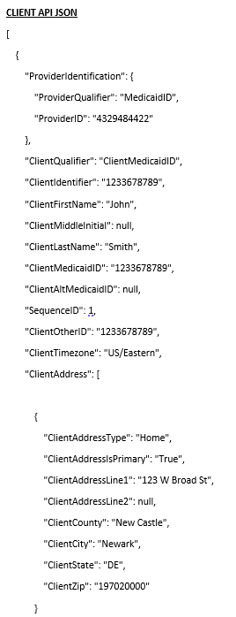
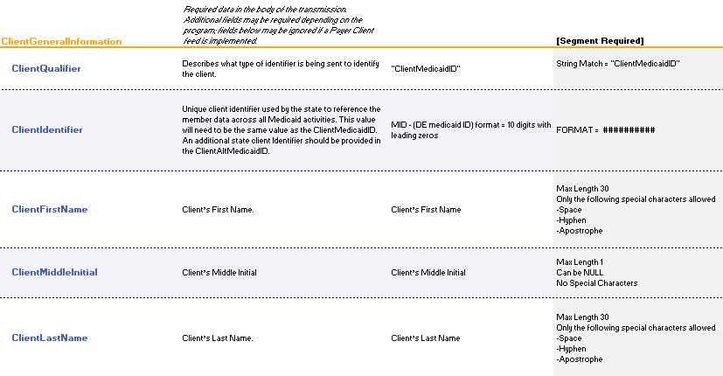
Client Overview: JSON
Alternate EVV data is sent via RESTful API / JSON transmissions

Slide 13
Employee Overview
    One required segment for employee (caregiver, care workers) records:
      Employee general
    Identifiers are used for matching logic:
      ProviderID values: 9 or 10 characters (MCD ID)
        MCD ID: 9 digits (e.g. 3000#####) or 10 characters = 9 digits + 1 alpha (e.g. 2########A)
      EmployeeIdentifier: 7-character identifier
        First 3 letters of last name + last 4 of SSN
          Last names with only 2 letters will be padded with zero before the last 4 of SSN
    Employee validation:
      EmployeeIdentifier will be matched to existing records to:
        No match = Insert new record
        Yes match = Update existing

Slide 14
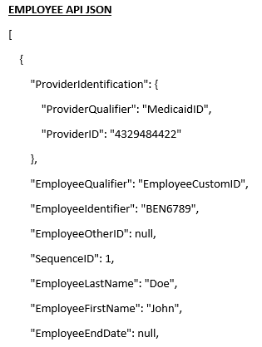
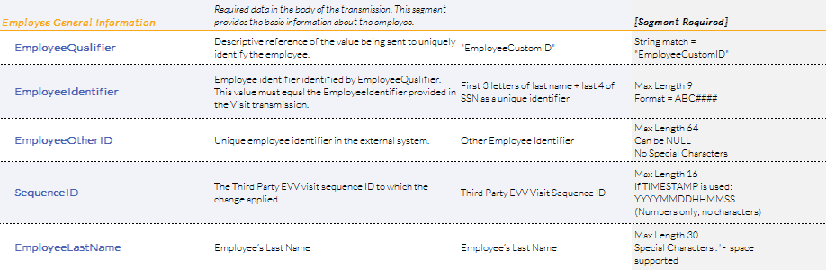
Employee Overview: JSON
Alternate EVV data is sent via RESTful API / JSON transmissions

Slide 15
Visit Overview
    One required segment for visit records:
      Visit general
    Four conditional segments for visit records:
      Calls
      Visit exceptions
      Visit changes
      Visit task
    Identifiers are used for matching logic:
      ProviderID values: 9 or 10 characters (MCD ID)
        MCD ID: 9 digits (e.g. 3000#####) or 10 characters = 9 digits + 1 alpha (e.g. 2########A)
      VisitOtherID values: ID from vendor system
      ClientIdentifier: 10 digits with leading zeros (MID)
      EmployeeIdentifier: 7-character identifier
        First 3 letters of last name + last 4 of SSN

Slide 16
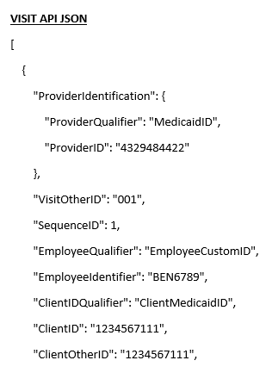
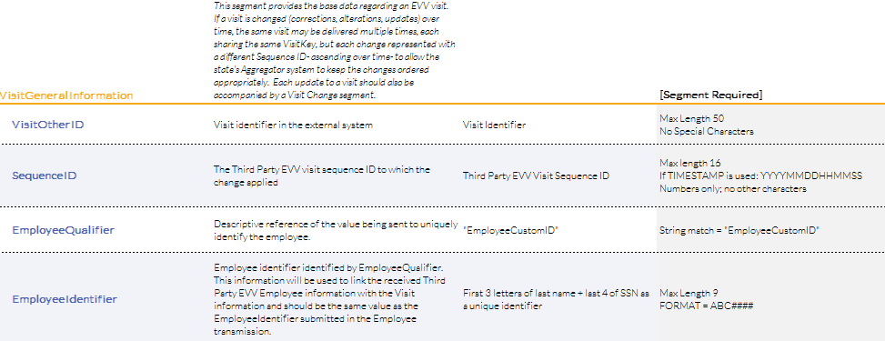
Visit Overview: JSON
Alternate EVV data is sent via RESTful API / JSON transmissions

Slide 17

Visit Overview
  Procedure code validation:
      PayerID, PayerProgram, ProcedureCode, and Modifiers must match to a valid record defined in the service appendix.
  ClientIdentifier must match to existing client record supplied by the state member data.
  EmployeeIdentifier must match to existing employee record.
  Conditional segments are required based on the condition for the segment:
      For example, when a change is required for a visit previously sent to the state Aggregator, the updated visit will require the VisitChange segment.

Slide 18
Visit Overview (continued)
The Alternate EVV system is expected to be able to handle a visit that crosses calendar days for a maximum of 24 hours.
AdjInDateTime and AdjOutDateTime Elements:
  Send with a value only if the time provided in the call segment is adjusted.
  Include a change log and reason code for the adjustment.
  Adjusted time in/time out times should only be provided for actual changes to start and end times (e.g. forgetting to call in or call out). Times should not be adjusted to align with the scheduled times.
Changes
  Send change log and reason codes for adjustments on the initial transmission of a visit.
  Send change log and reason codes for changes on a subsequent transmission of a visit.

Slide 19
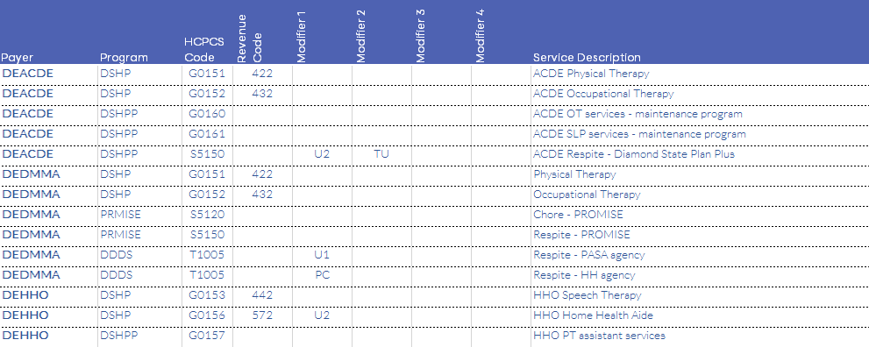
Service and Modifiers

Slide 20
Visit Exceptions
Exception Code | Acknowledge/Fix | Exception
00 | Fix | Unknown Client
01 | Fix | Unknown Employee
02 | Fix | Visits Without Any Calls
03 | Fix | Visits Without In-Call
04 | Fix | Visits Without Out-Call
23 | Fix | Missing Service
Exceptions ensure data aligns with the program definition for the DE DHSS EVV program.
Some DE DHSS exceptions will cause visit rejections; therefore, they are not “acknowledgeable” via the API.
  For example, an invalid service provided on a visit transmission for the DE DHSS EVV program will require correction before the visit will be accepted.
Visits without in-calls, visits without out-calls, and Unauthorized/Invalid Service will need to be fixed in the source system and resubmitted to the DE DHSS Aggregator as an update to an existing visit.

Slide 21
Common Support Issues

Slide 22
Common Support Issues
Invalid Credentials:
  Error message: "Request contains the following providers that are not authorized for the given account and credentials: [ProviderID]“.
  What can we do to troubleshoot?
      Contact Sandata at DEAltEVV@Sandata.com for credential support.

Slide 23
Common Support Issues
Client Not Found – Error Code -1021 (Visit Record)
Error message: “Client not found”
Root cause 1:
  Client doesn’t exist in agency account:
    Client JSON failed to be created
    Transmission of visit data with unknown client identifier
What can vendors do to troubleshoot?
  Check the state Aggregator to ensure client record was successfully added to the provider agency account.
  Check the Alternate EVV addendum for the format and ensure the correct value for the client is in the correct field.
  Ensure visit client identifier matches client identifier on client record.

Slide 24
Common Support Issues
Worker Not Found – Error Code -1031 (Visit Record)
Error message: “Worker not found”
Root cause 1:
  Employee not properly specified:
    Employee identifier is not correctly formatted. For example, the program requires an improper transmission format where a valid employee identifier is in the wrong JSON field.
What can vendors do to troubleshoot?
  Check the Alternate EVV addendum for the format and ensure the correct value is in the correct field.
  Possible next steps:
    Contact Sandata Alternate EVV support for additional troubleshooting that may be required.
    Perform visit maintenance to correct the employee identifier.

Slide 25
Common Support Issues
Service ID – Error Code -553 (Visit Record)
Error message: “Error during retrieving service service_id entered”
Root cause 1:
  Missing service in visit:
    All visits must include the service provided to the member.
What can vendors do to troubleshoot?
  Check the Alternate EVV addendum for the valid service, and if applicable, modifier field combinations and order to ensure the provider has the correctly formatted value in the correct field.
  Possible next steps:
    Sandata investigation of service code and visit processing with Sandata Engineering teams may be required.
    Perform visit maintenance to correct or add the service code.

Slide 26
Common Support Issues
Service ID – Error Code - 553 (Visit Record)
Error message: “Error during retrieving service service_id entered”
Root cause 2:
  Incorrectly formatted service in visit:
    All services and modifiers are recommended to follow the case per the specification.
    Services that require modifiers should follow the modifier order. For example, if T1005 U1 is a valid service code with modifiers, then a visit submitted as t1005 u1 may be an invalid combination of modifiers for visit verification.
What can vendors do to troubleshoot?
  Check the Alternate EVV addendum for the valid service, and if applicable, modifier field combinations and order to ensure the provider has the correctly formatted value in the correct field.
  Possible next steps:
    Additional investigation of service code and visit processing with Sandata Engineering teams may be required.
    Perform visit maintenance to correct or add the service code.

Slide 27
Integration Best Practices
  Send clients (members) records first:
      Send all clients as soon as possible.
      Check status to ensure client loaded successfully.
  Send employee (caregiver) records second:
      Send all caregivers as soon as possible.
      Check status to ensure caregiver loaded successfully.
  Send visits once clients and employees have loaded.
  Continue to send visits on your defined schedule.
  Send new clients as they are created or as an existing record is updated.
  Send new employees as they are created or as an existing record is updated.

Slide 28
Support Resources
DE DHSS EVV website
  Resources for the Alternate EVV vendors and agencies
  Link: https://dhss.delaware.gov
Sandata DE Alternate EVV support
  Email: DEAltEVV@Sandata.com
Sandata on Demand (SoD)
  Sandata Alt EVV Resources Website
Gainwell Provider Relations Team
  1-800-999-3371

Slide 29
Thank You

